Slide 1


The George Washington University
Meet the team
SANJANA K M
ADITYA KANBARGI
JAHNAVI V
ANNIE CHENG
DEAD ENDS AND DATA TRENDS
A journey through America’s recent accident stats

Slide 2








Slide 3




Data source:
Fatality Analysis Reporting System (FARS),
Bureau of Transportation statistics
(US dept. of Transportation)
DATASET OVERVIEW
39481 Records
83 features
34 Categorical data
49 numeric data

Slide 4
Features of Interest
st_case
unique identifier depicting case no.(numeric)
statename
Char- categorical different states in USA like virginia..
countyname
Char- Categorical- different counties in each state like Arlington..
rur_urbname
Rural, Urban (categorical)
day
day of the month- discrete integer
day_weekname
categorical-monday to sunday
monthname
categorical- January to december
hour
numeric- discrete 0 to 23 representing 24 hour clock

Slide 5

Features of Interest
routename -
Identifies the route signing of the trafficway (categorical)
funcsysname
Functional classification of the segment of trafficway - Ex - Interstate (categorical)
lgt_condname
The lighting condition during the time of crash (categorical)
weathername
The weather during the time of crash
(categorical)
arr_min -
Minutes after the hour that EMS arrived on the crash scene (numeric)
fatals
The number of fatalities (numeric)

Slide 6

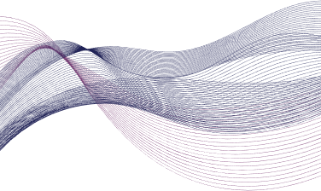

Importing all the crucial libraries
readr, dplyr, tidyr, stringr, ggplot2, plotly, shiny
Identifying and handling the missing values
3 columns - TWAY_ID2, X AND Y with a huge number of NA values.
DATA PREPROCESSING
Enhancing data quality
Dropped 40 columns which were duplicates and irrelevant.
Cleaned the column names by renaming for consistency.
Converting variables into the correct data types
Converted categorical variables into factors
Outlier detection and handling
IQR Method
83 → 42 Columns

Slide 7
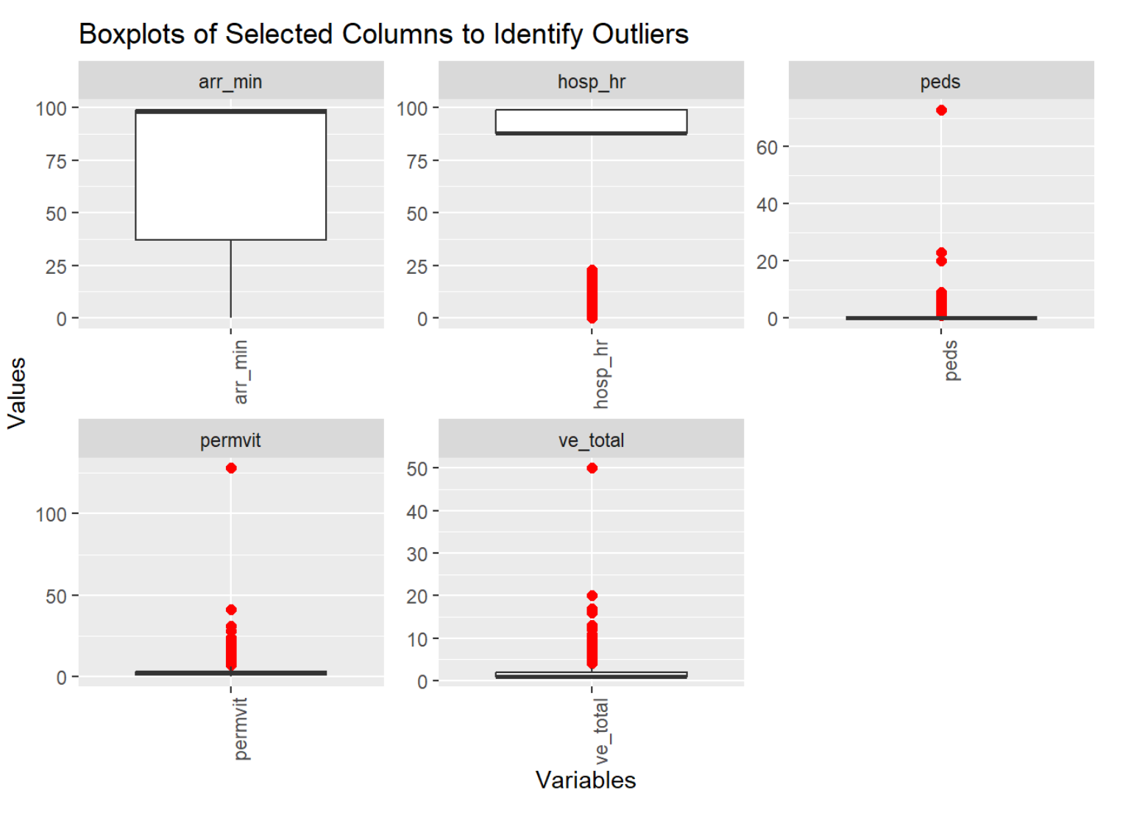
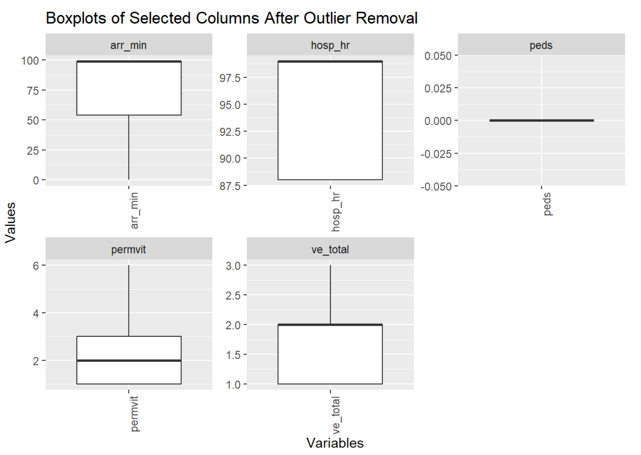
OUTLIERS
BEFORE OUTLIER REMOVAL
AFTER OUTLIER REMOVAL

Slide 8





How do day of week and hour of day affect the occurrence and severity of fatal accidents?
SMART QUESTIONS
Q1
Q2
Q3
Q4
Q5
How do temporal factors influence the occurrence of accidents?
What is the Impact of environmental conditions on fatalities?
How do Infrastructure influence crashes?
Explain the trends in fatal accidents over time?
Does EMS arrival time influence the number of fatalities?

Slide 9
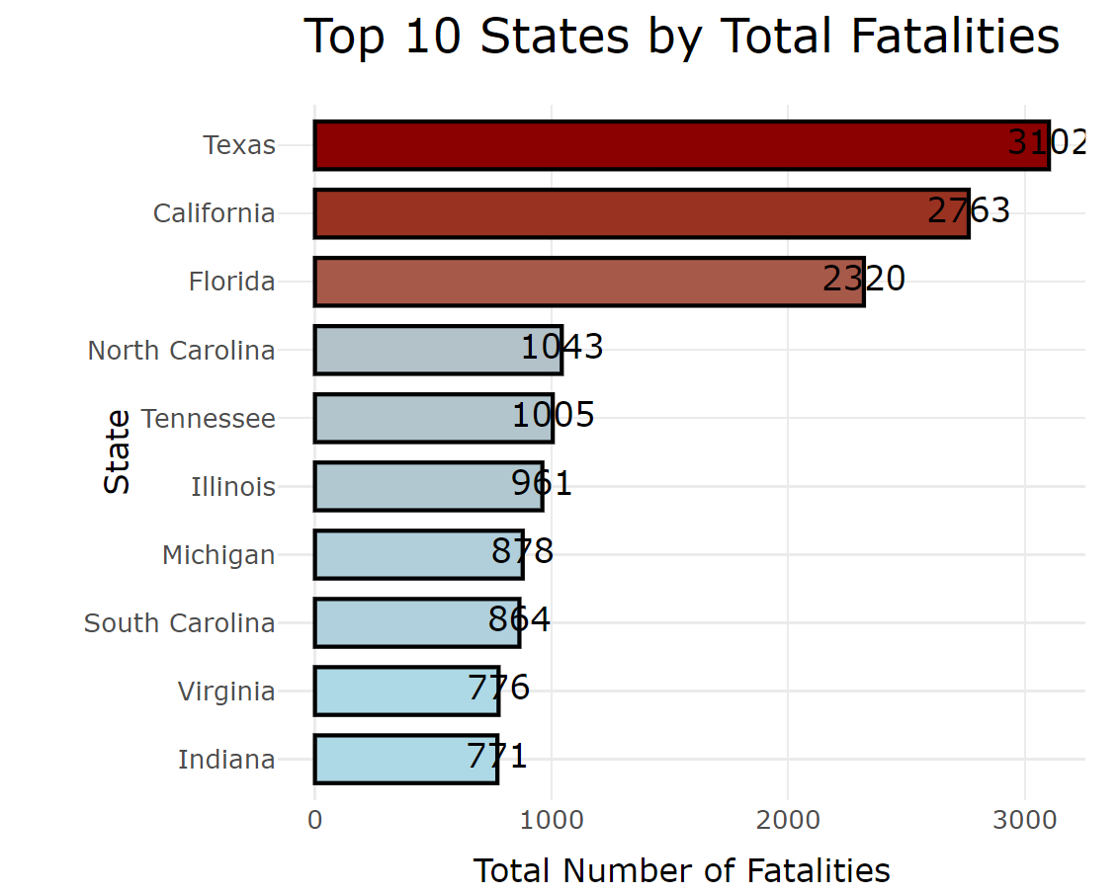
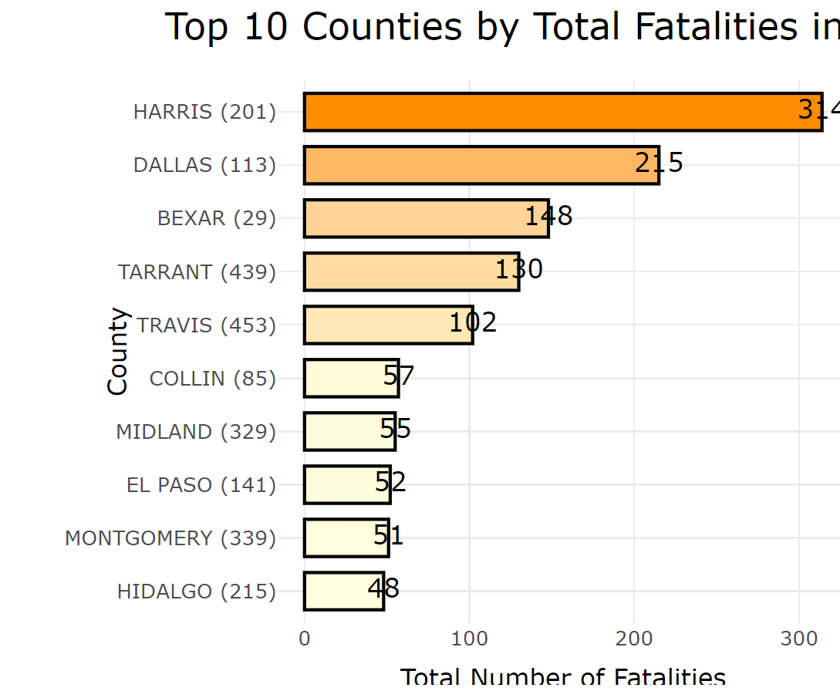
Drill-Down Analysis of Crash Fatalities by State and County

Slide 10
SMART Question 1
How do day of week and hour of day affect the occurrence and severity of fatal accidents?

Slide 11
Accident Occurrence Analysis

Slide 12
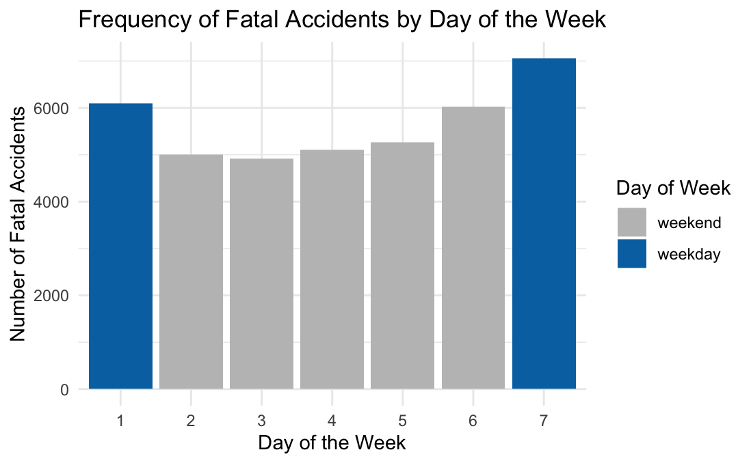
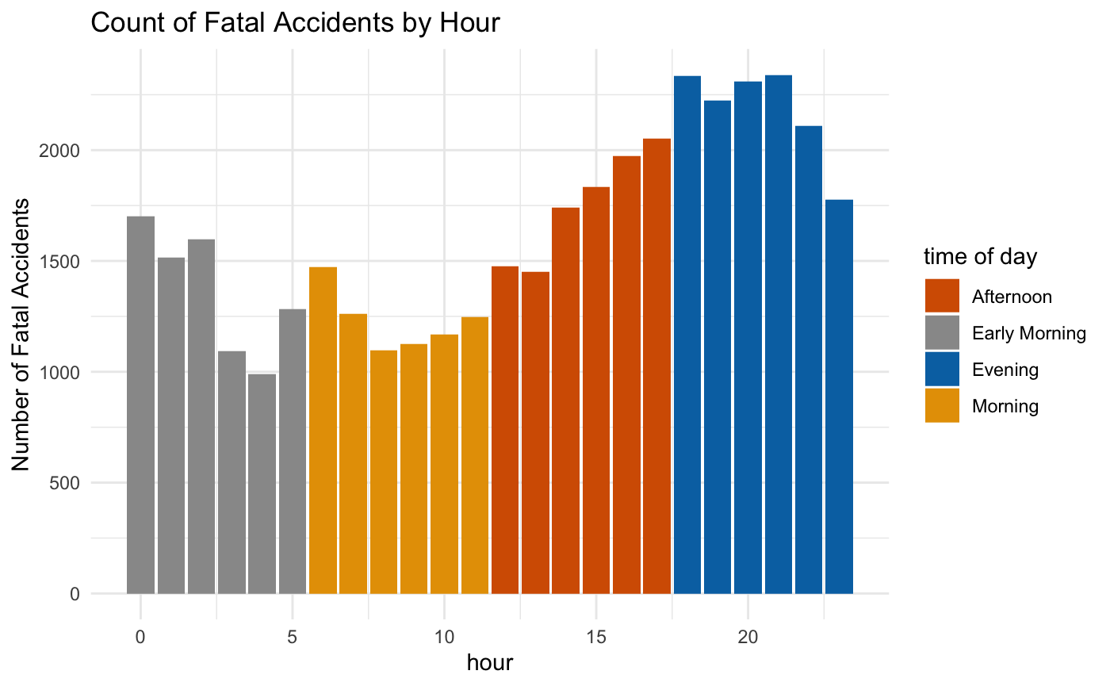
Accident Occurrence Analysis:
Day of Week & Hour of Day
Chi-Squared Goodness-of-Fit Test
p-value < 2.2e-16
Chi-Squared Goodness-of-Fit Test
p-value < 2.2e-16

Slide 13
Fatality Analysis
One vs Multiple Fatalities per Accident

Slide 14
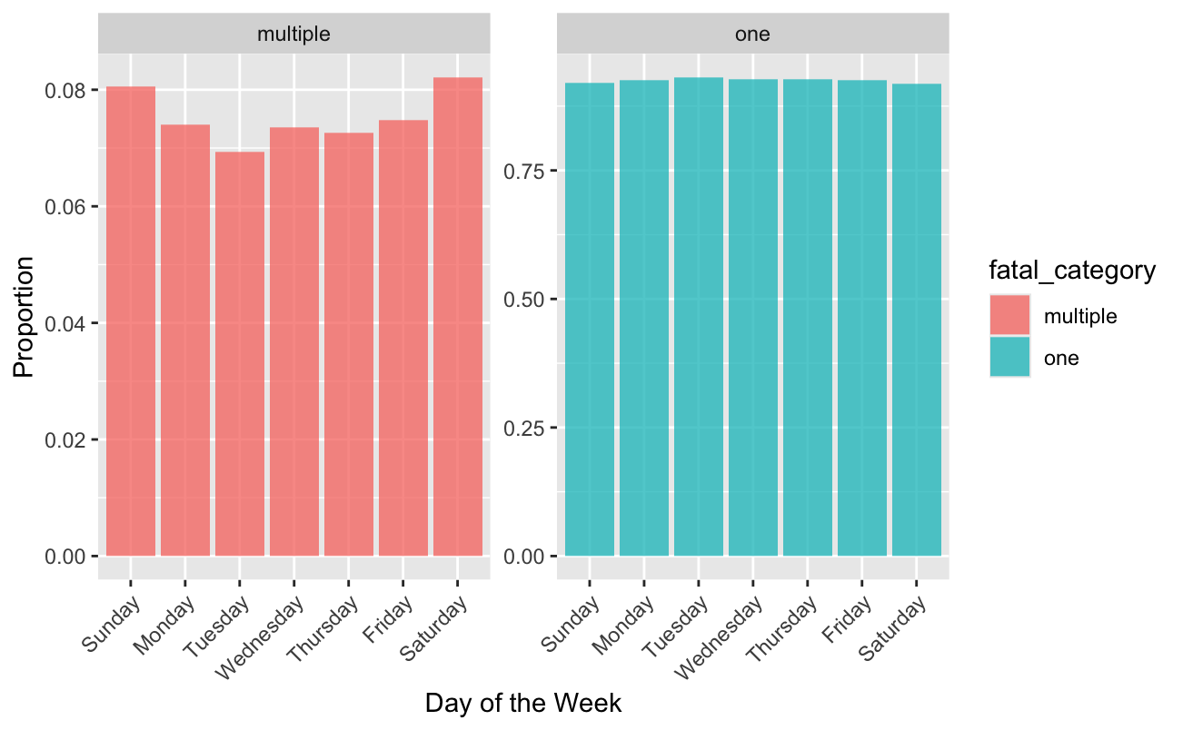
Fatality Analysis: Day of Week
Chi-Squared Test
p-value = 0.006

Slide 15
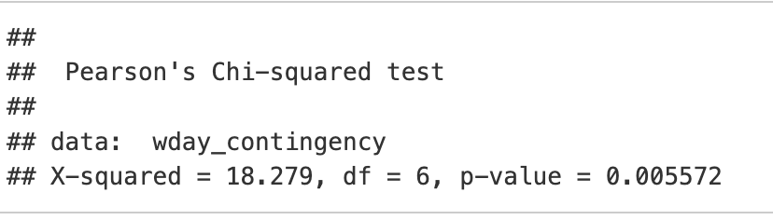
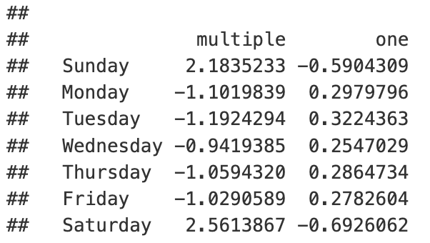
Standardized Residuals
Notes:
Weekends have

Slide 16
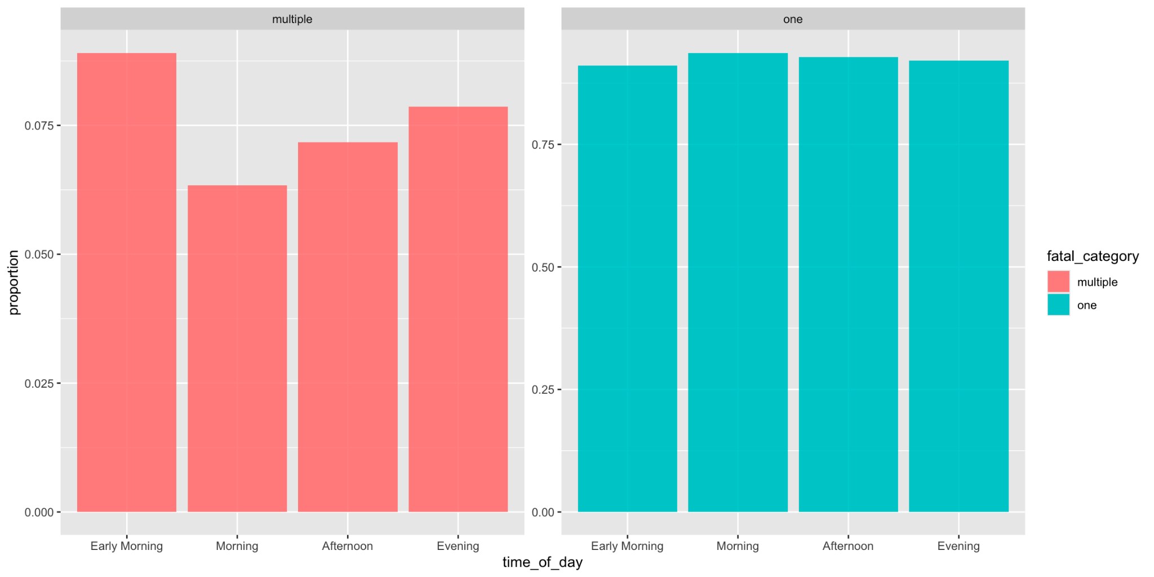
Fatality Analysis: Hour of Day
Chi-Squared Test
p-value = 2e-05

Slide 17
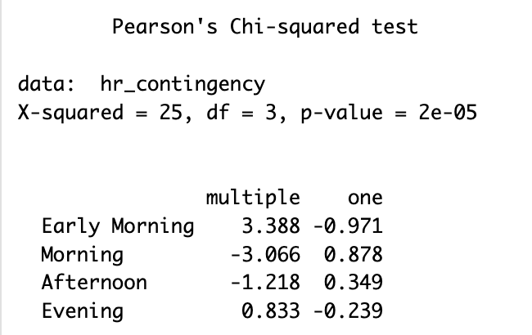
Standardized Residuals

Slide 18
SMART Question 2
How does weather and lighting conditions affect the severity of fatal accidents?

Slide 19
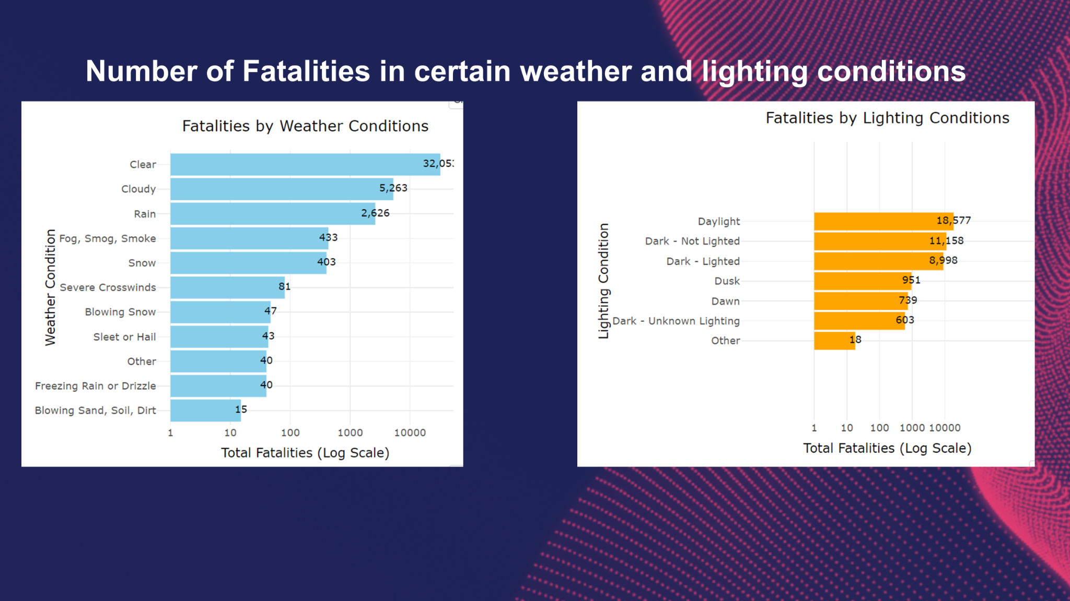
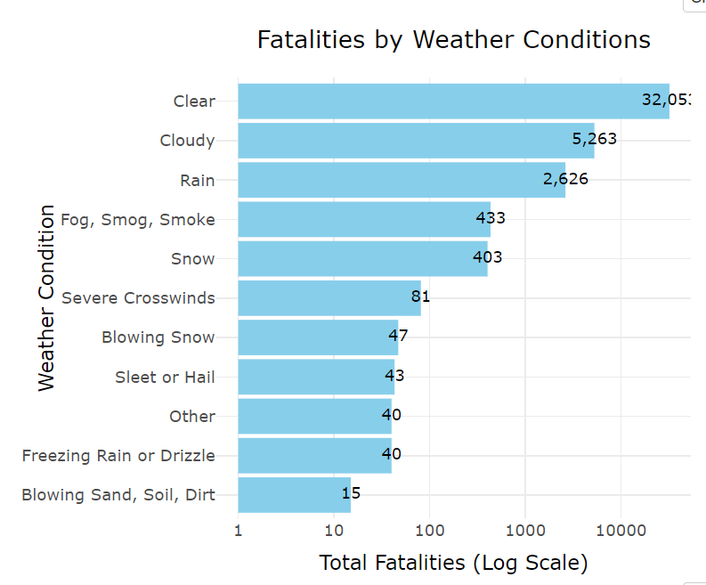
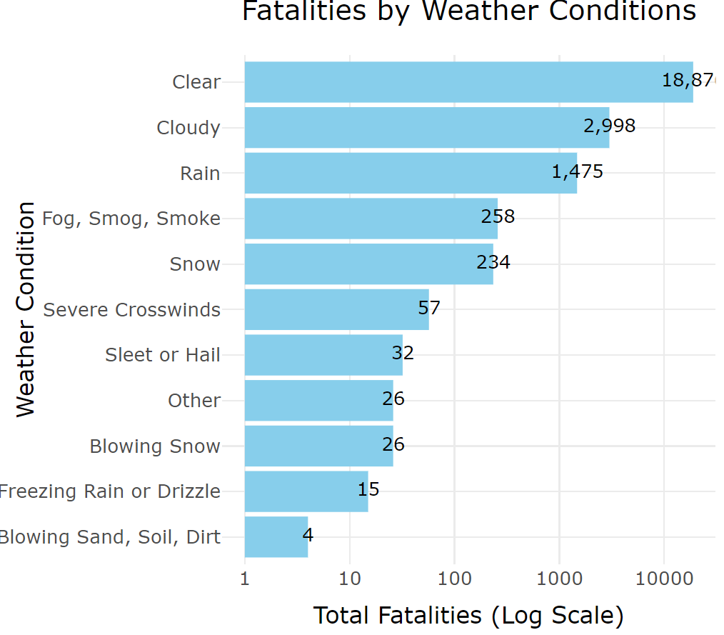
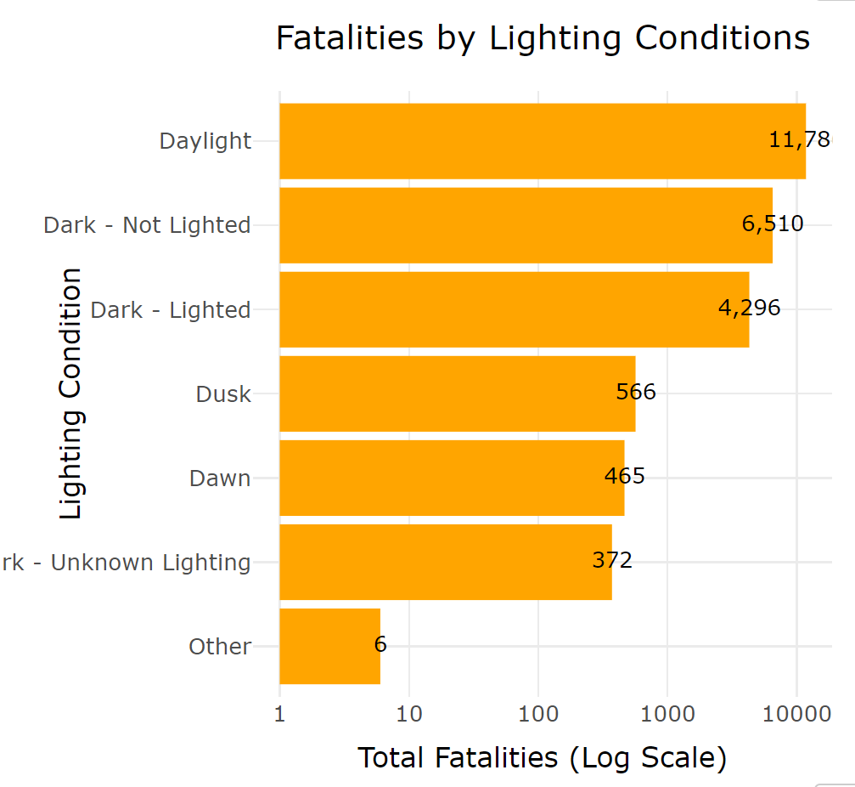
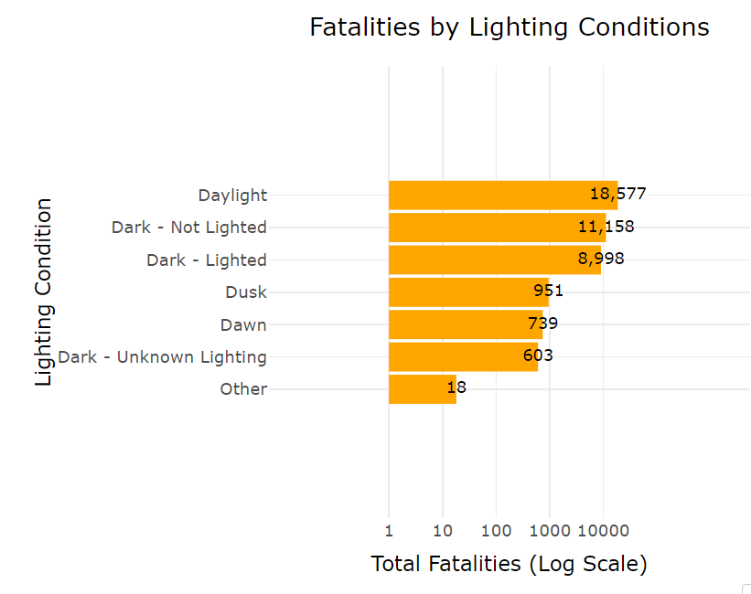
H

Slide 20
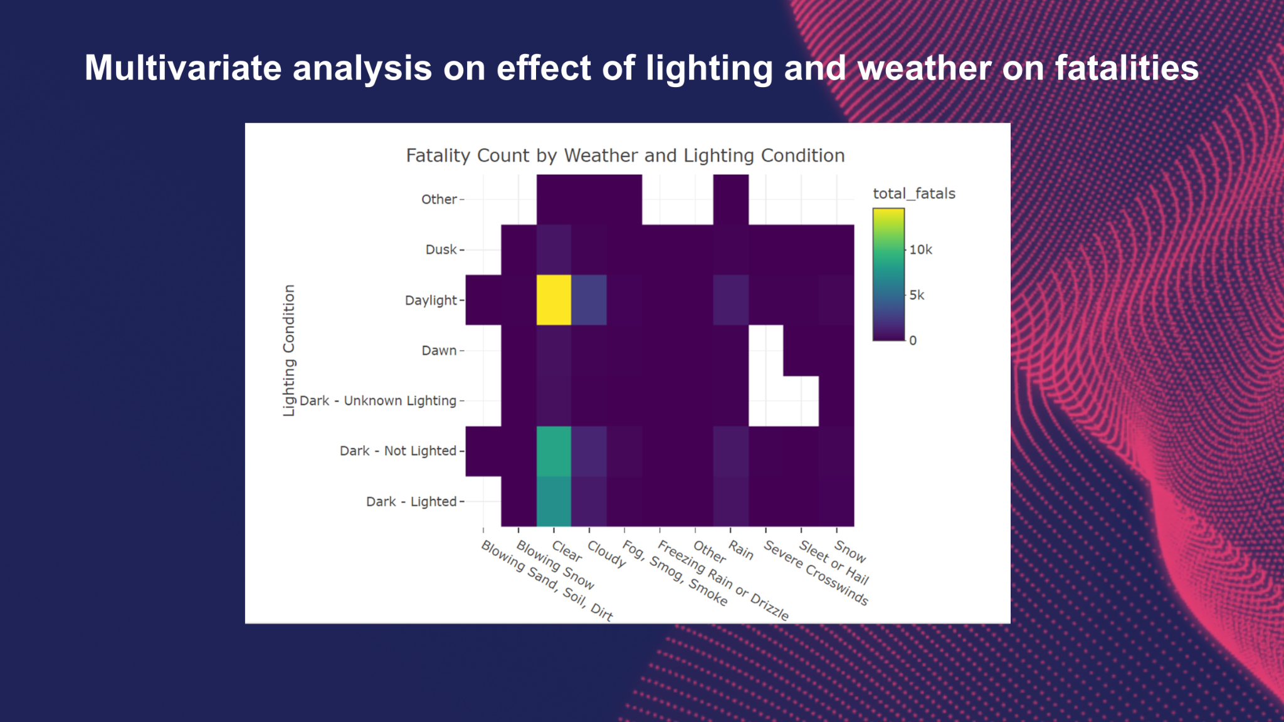
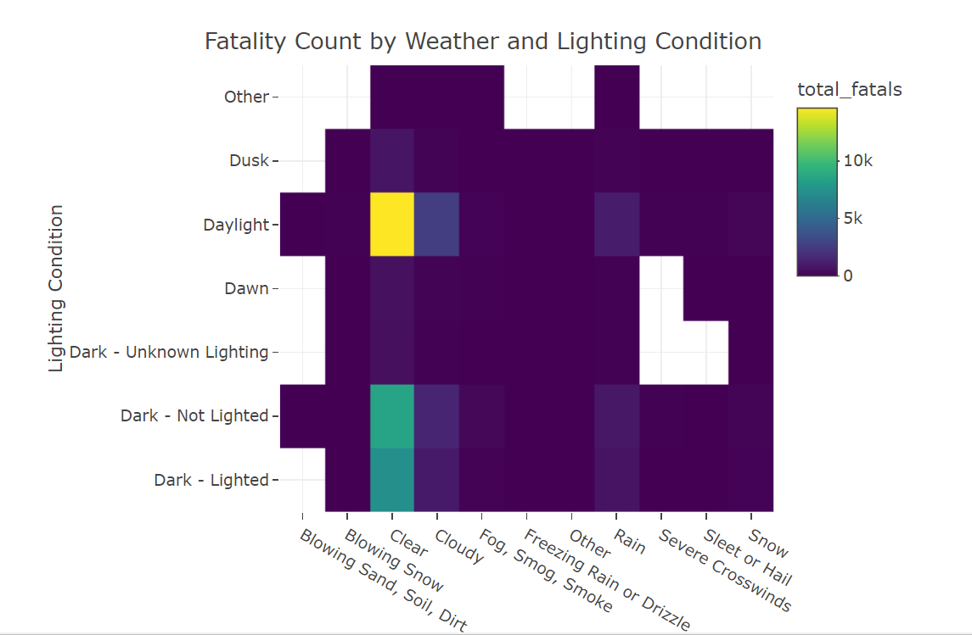
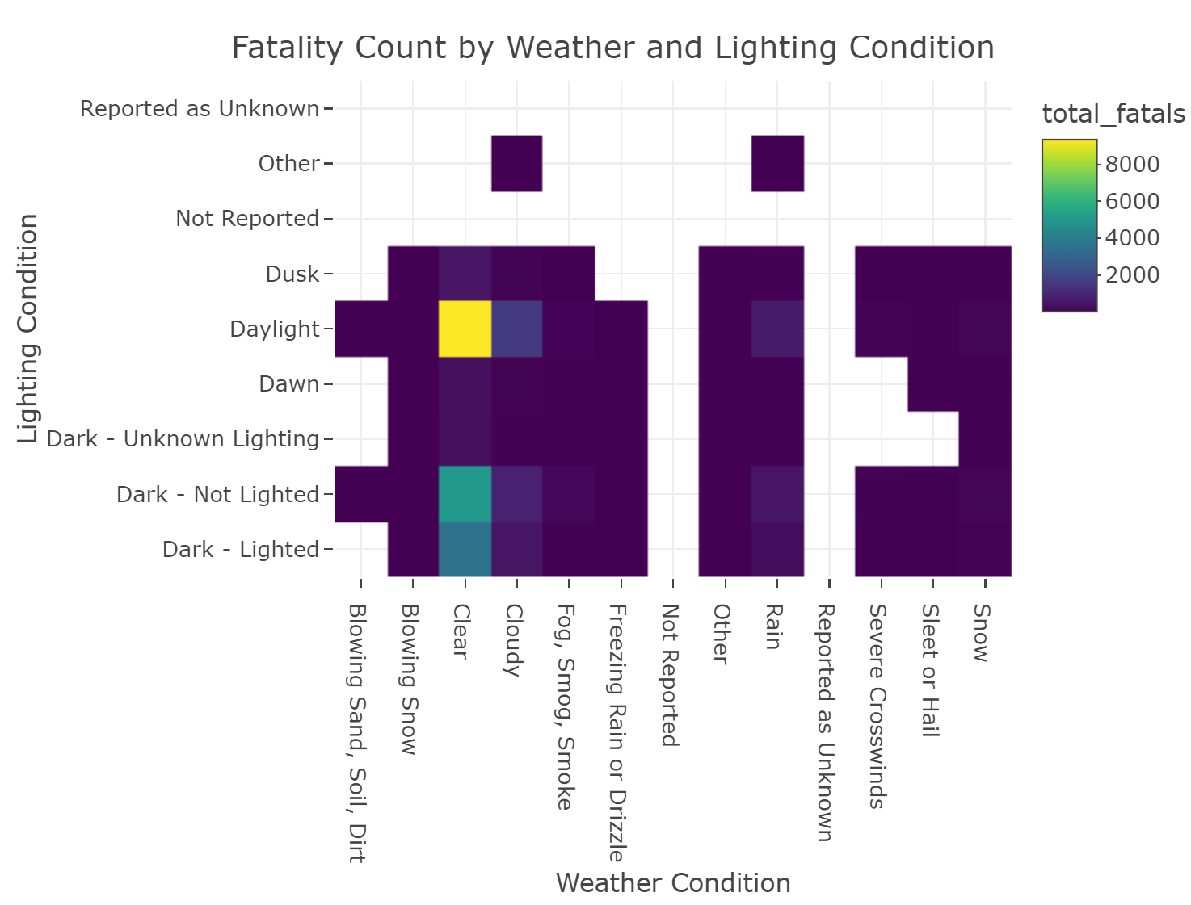

Slide 21

State-Level Analysis of Fatal Accidents in Adverse Conditions

Slide 22
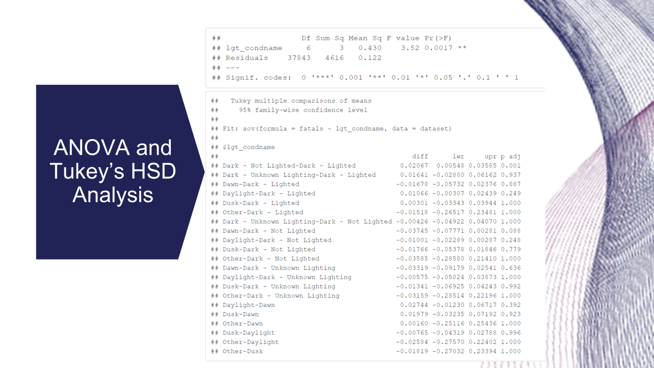
State-Level Analysis of Fatal Accidents in Adverse Conditions

Slide 23
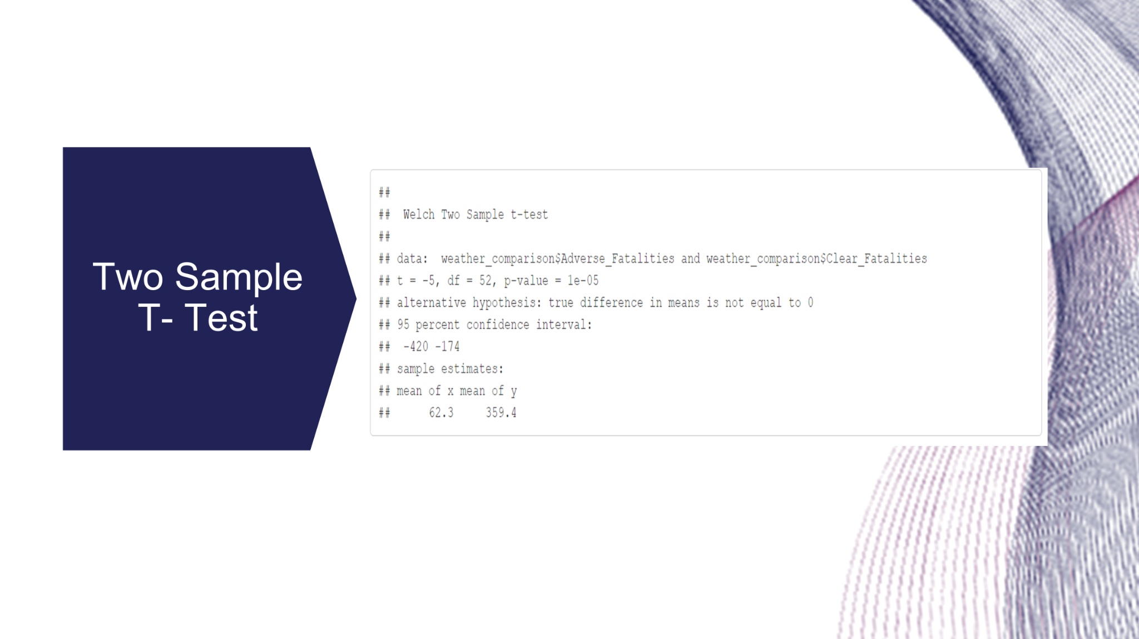

Slide 24
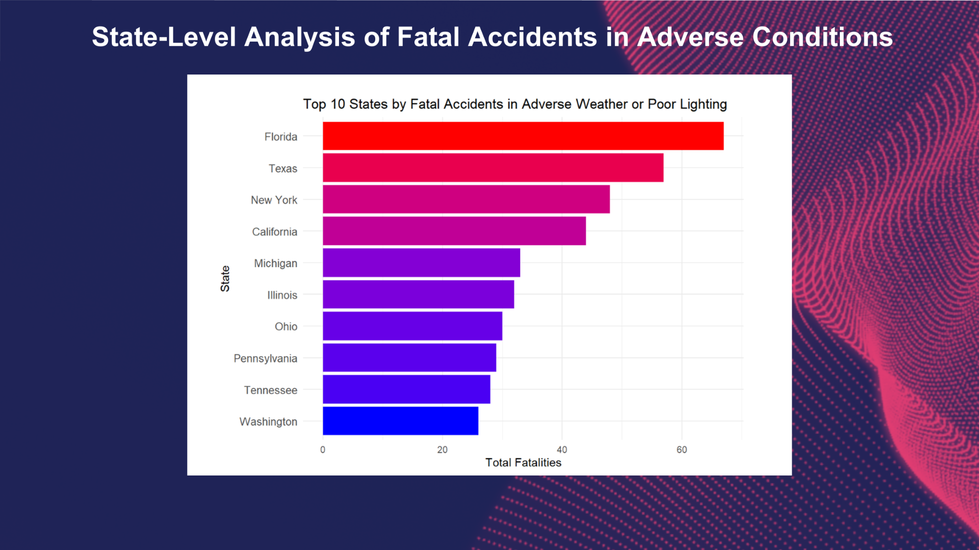
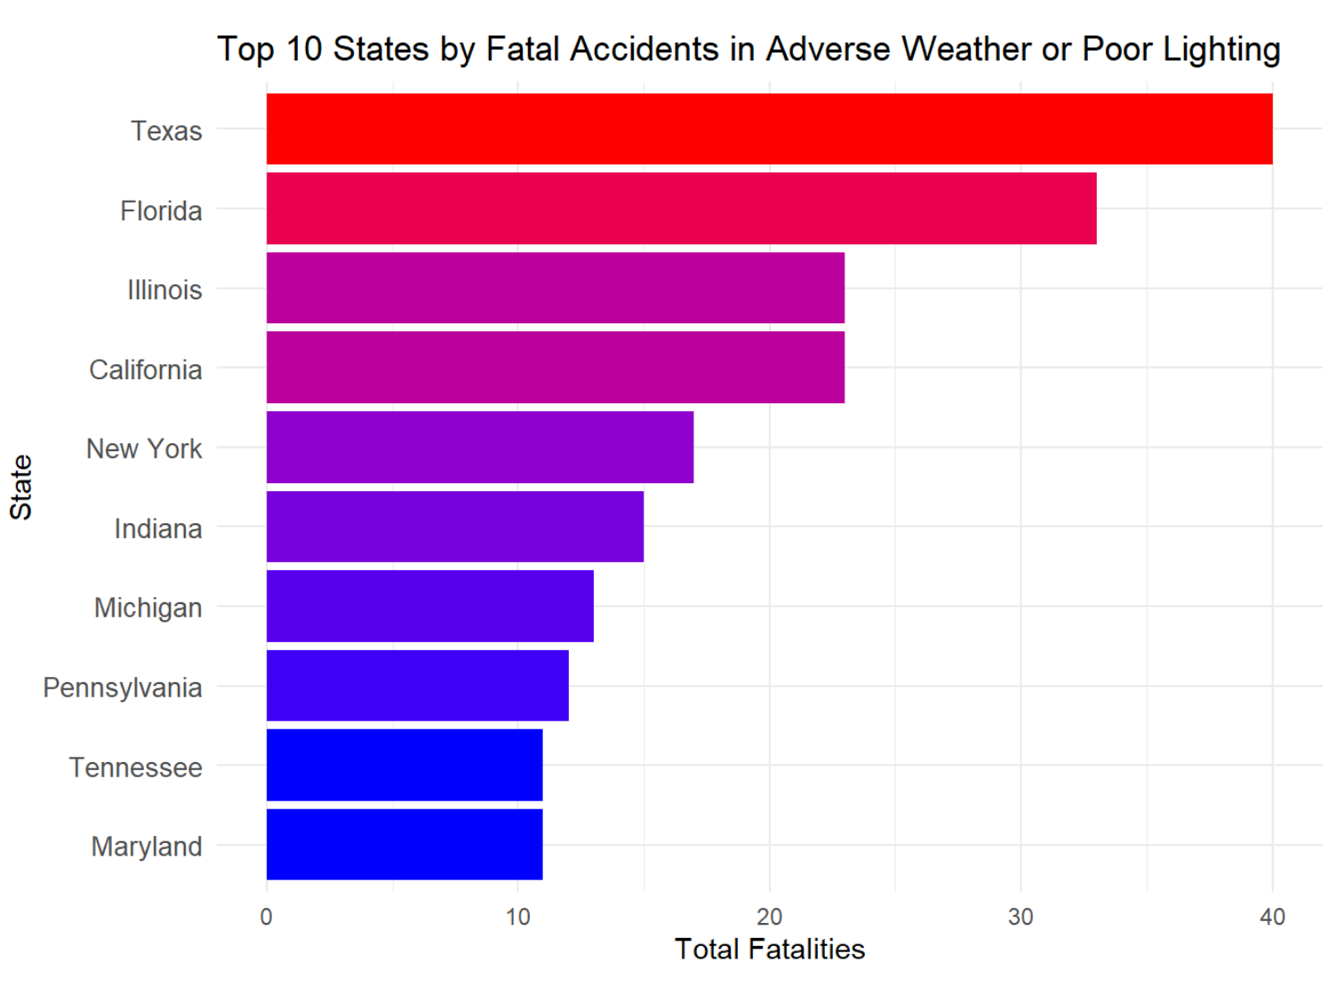
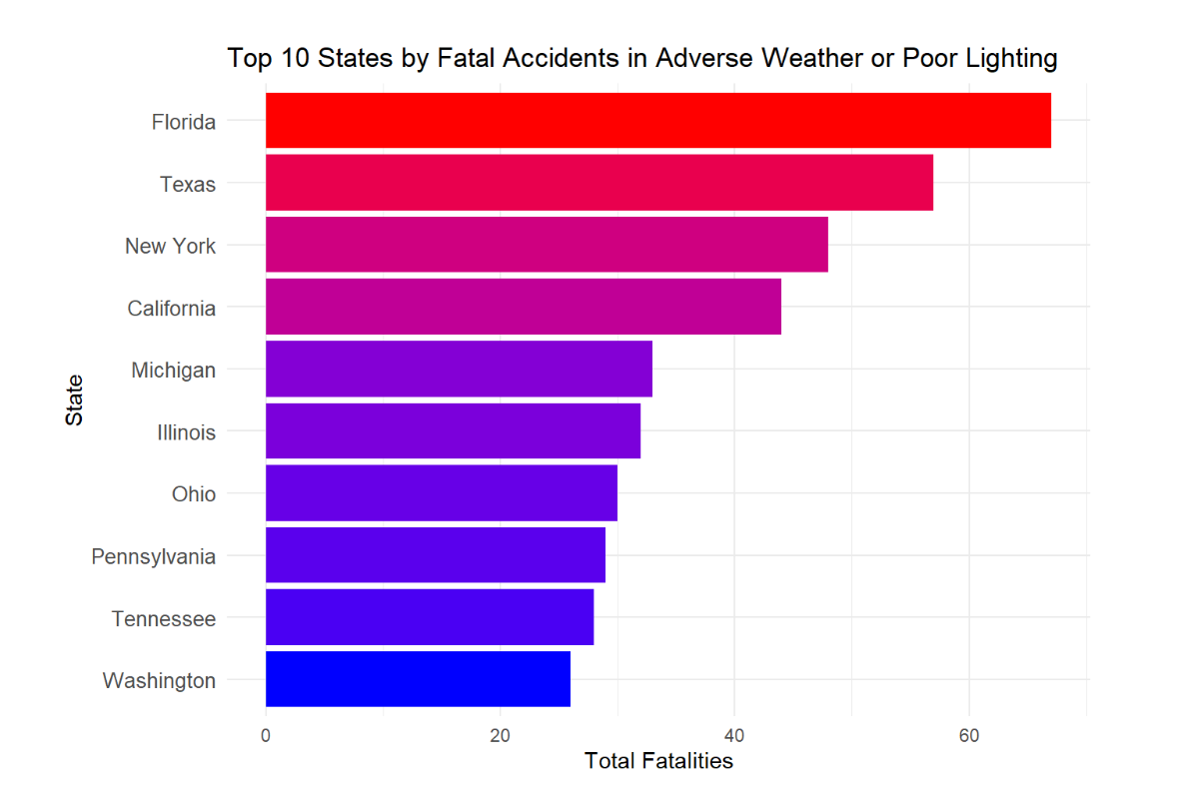

Slide 25
SMART Question 3
What is the impact of infrastructure (road type routes and intersections - for both urban and rural ) on the severity of crashes?

Slide 26
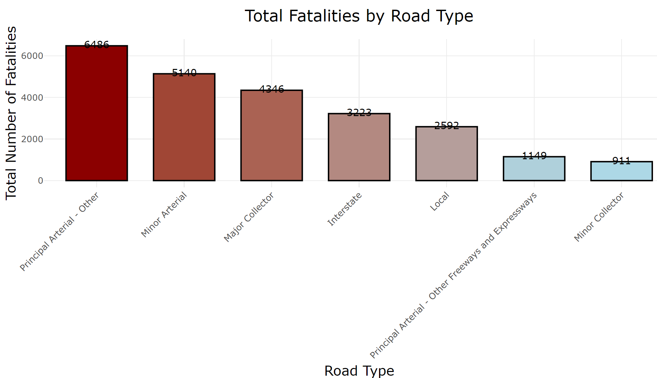
Analyzing the total fatalities by the type of road
Chi-Squared Goodness-of-Fit Test
p-value < 2.2e-16

Slide 27
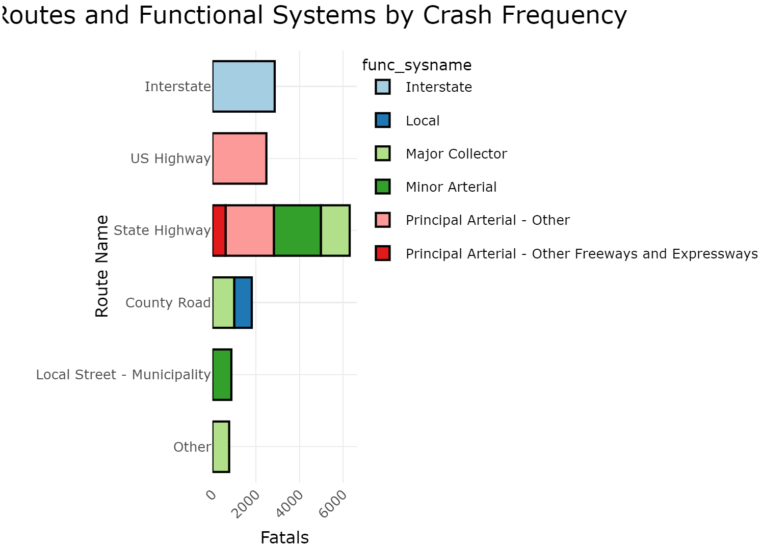
Identifying the top fatal routes by route name and functional system name

Slide 28
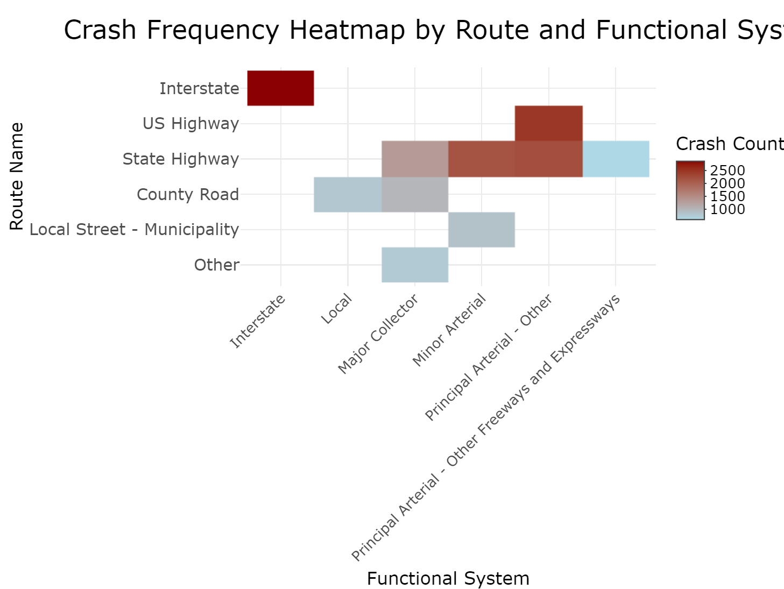

Slide 29
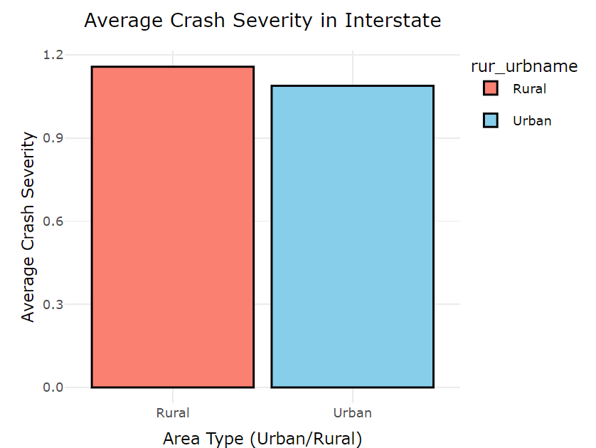
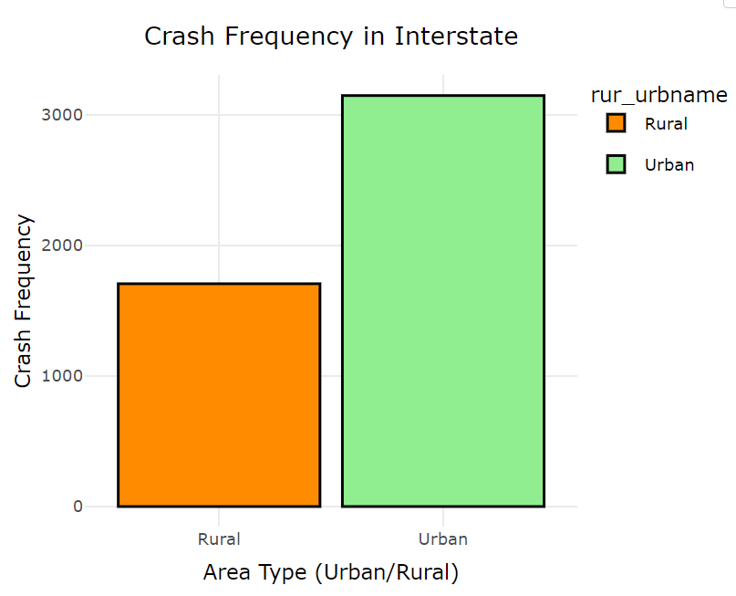
Comparing Crash Characteristics on Urban vs. Rural Functional Systems

Slide 30
SMART Question 4
Are there any noticeable trends in fatal accidents through the year 2022? Has the number of fatalities been increasing or decreasing in certain regions?

Slide 31
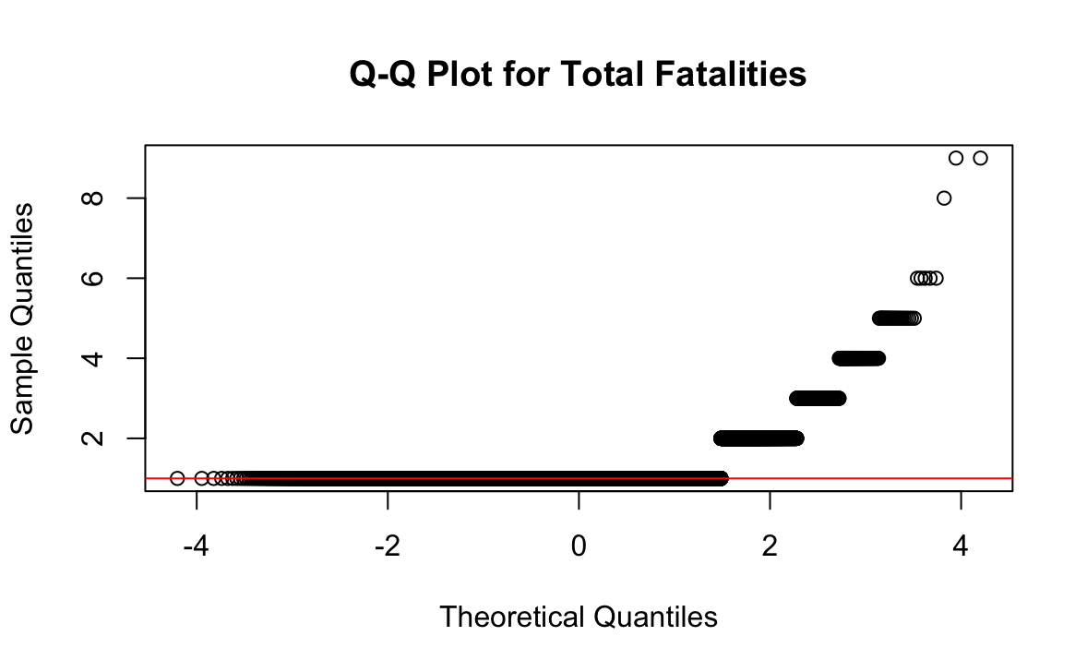
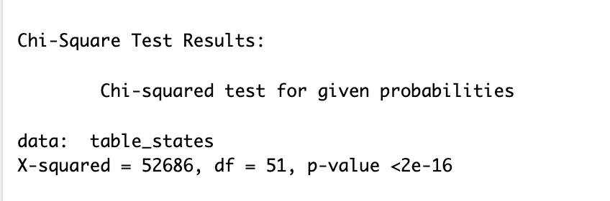

Slide 32
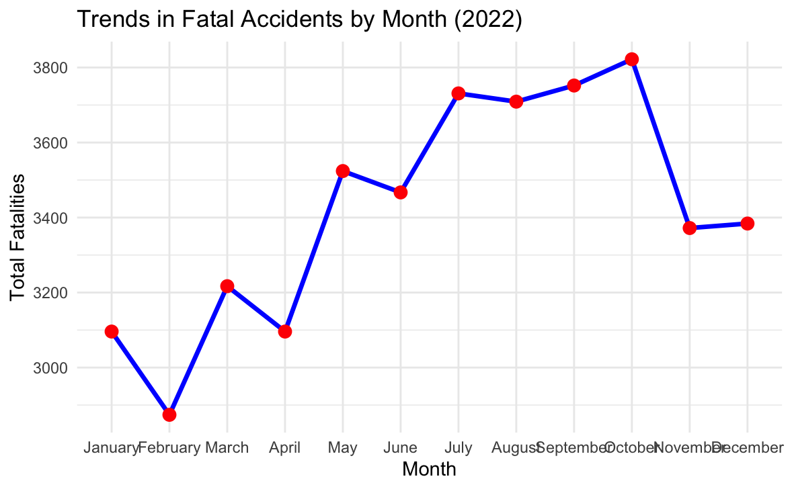

Slide 33
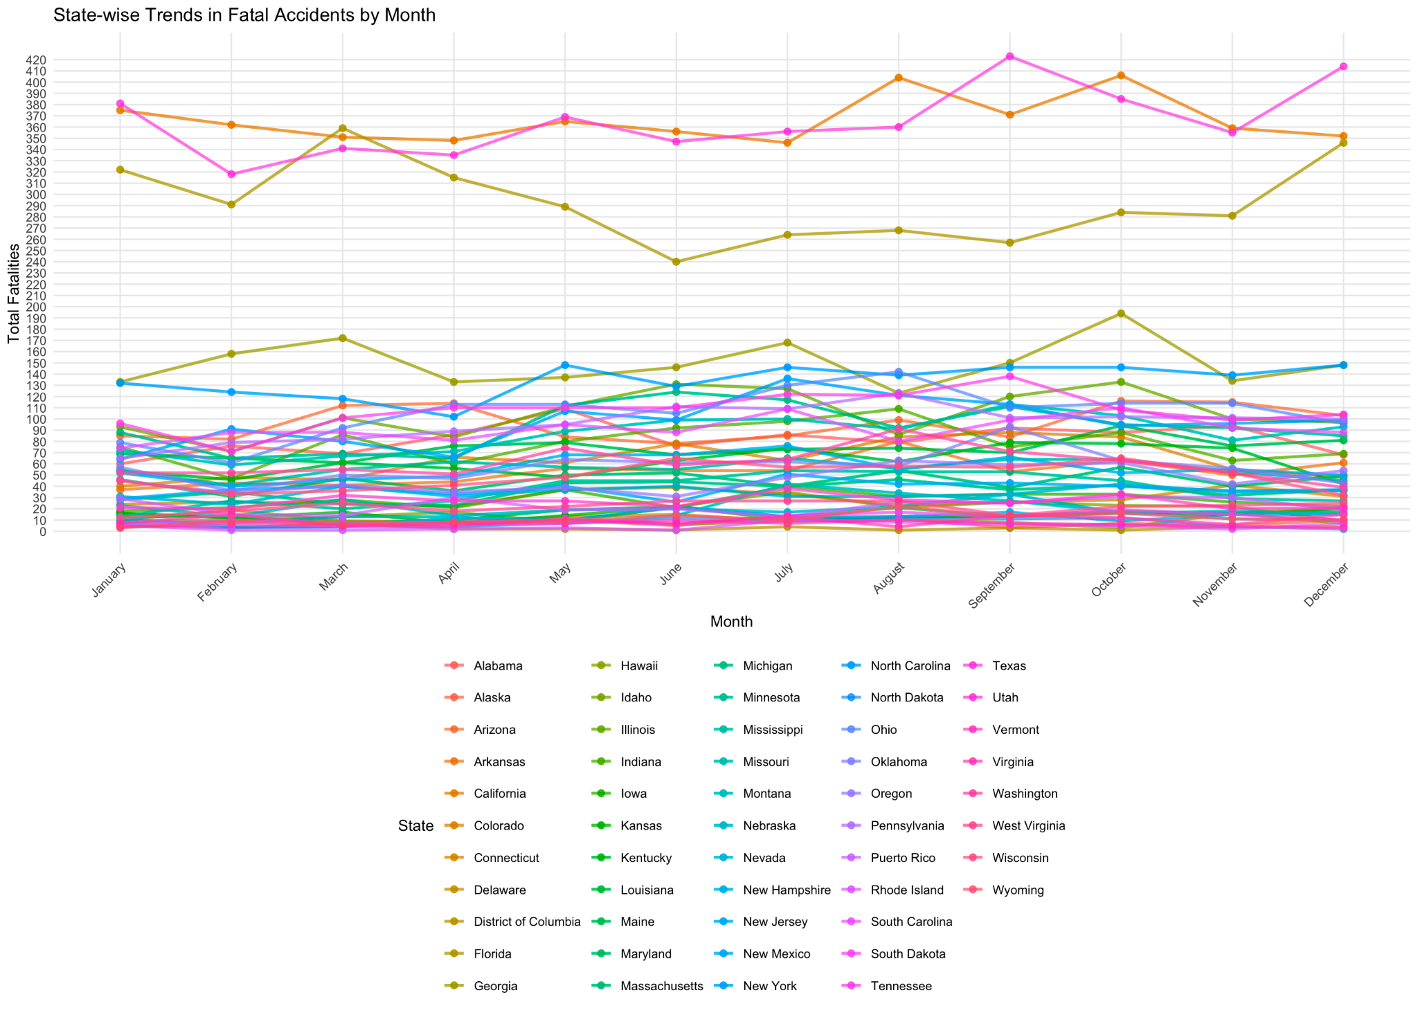

Slide 34
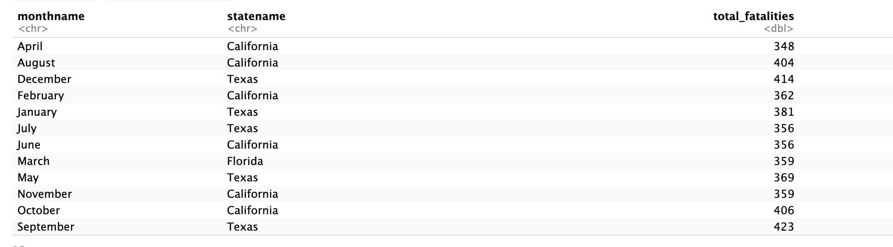
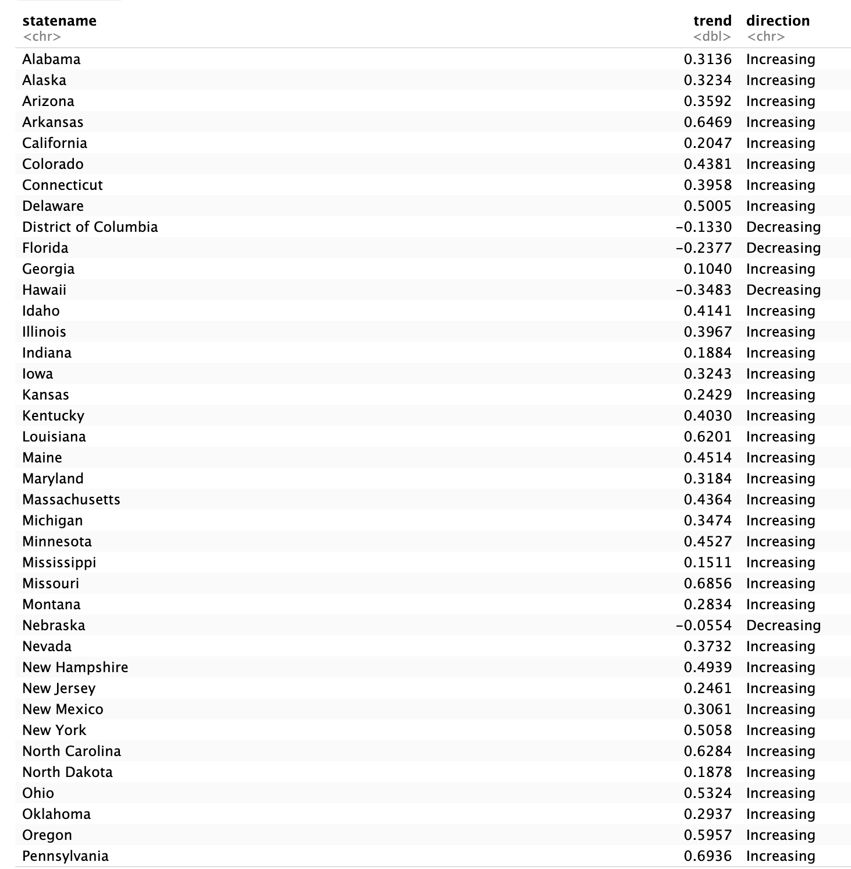
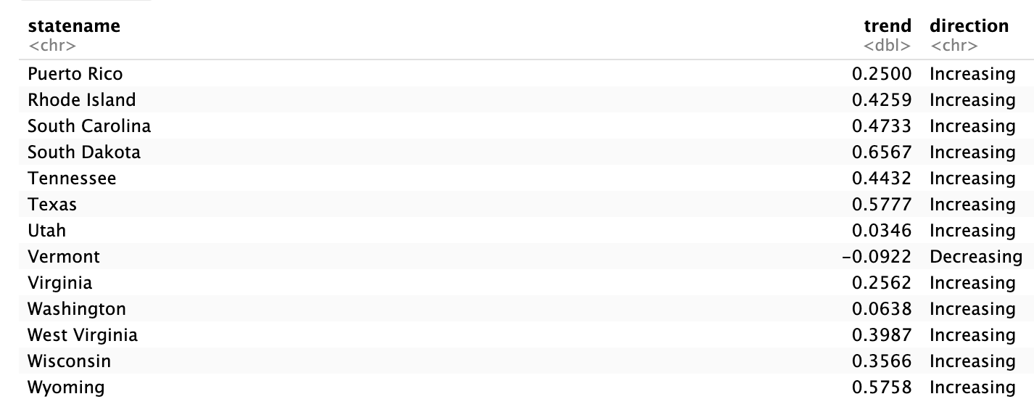

Slide 35
SMART Question 5
Does the EMS arrival time influence the number of fatalities?

Slide 36
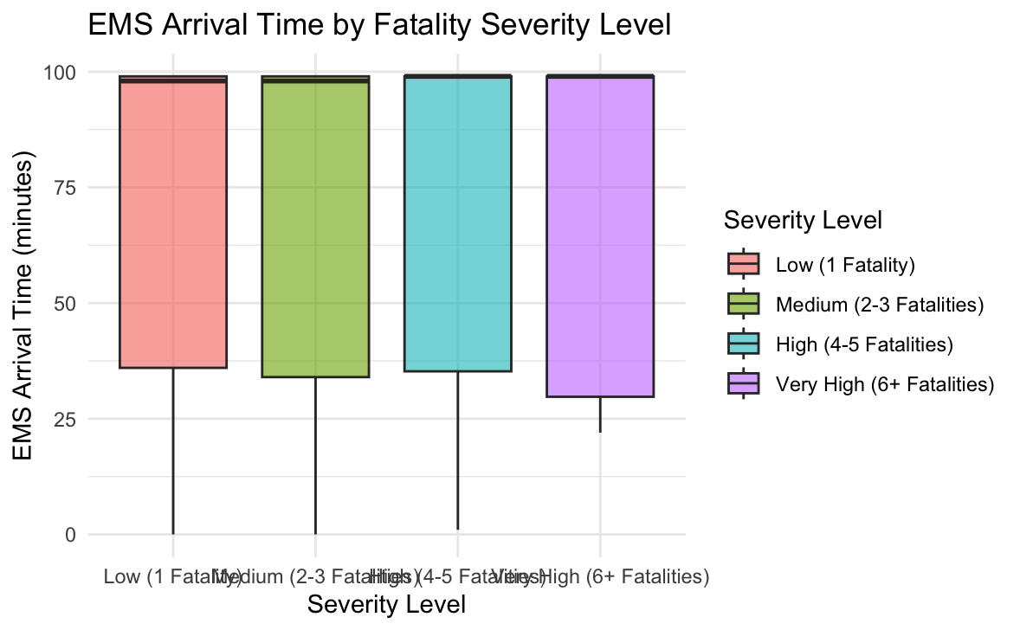

Slide 37
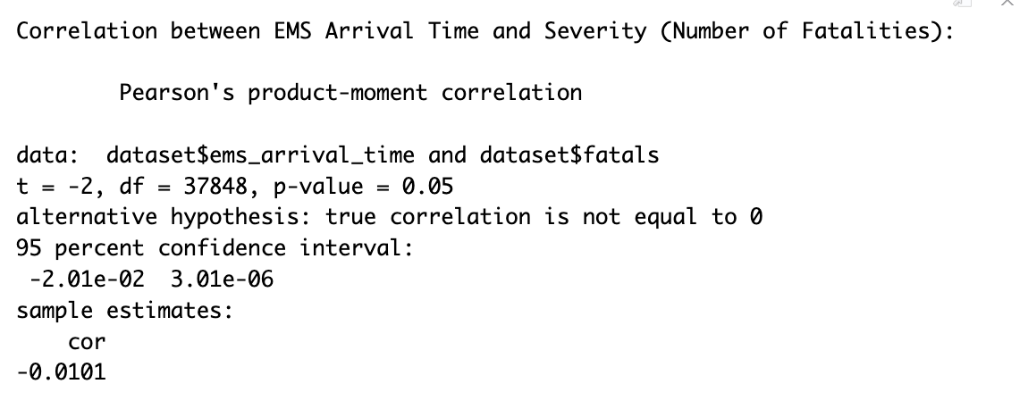

Slide 38
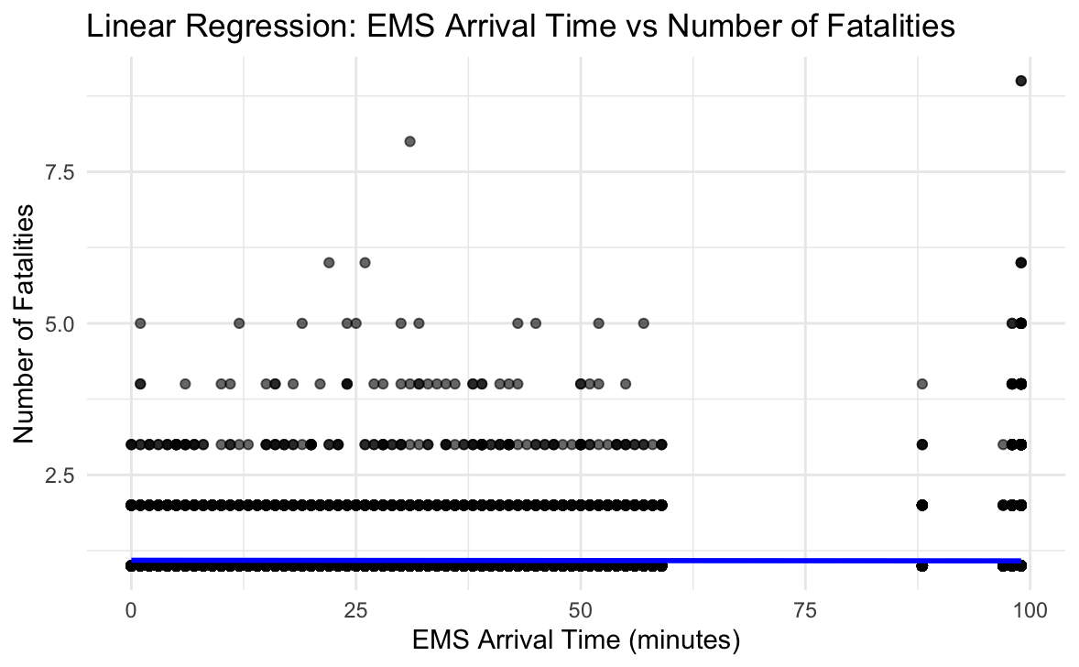
There is no significant relationship between EMS arrival time and severity of accidents

Slide 39
CONCLUSION
Key Findings
Fatal accidents are more frequent between 6 pm and 10 pm and on weekends, with late-night hours linked to increased severity
Clear weather conditions see the highest fatalities, while poorly lit roads (“Dark - Not Lighted”) have elevated risks.
Highways and major arterials report the most fatalities, likely influenced by higher speeds and traffic volume.
EMS response time did not significantly affect fatality severity, suggesting a greater need for preventive measures over emergency response.
Limitation
Solely focus on accident file, excluding critical behavioural aspects like impaired driving or motorist fatigue
Each factor (temporal, environmental, and infrastructural) is analyzed individually.
Further considerations: Cross Factor Analysis
To gain more comprehensive understanding, further analysis should integrate these factors, examining the interactive effect on fatal accidents
investigate the underlying explanation for our analysis result

Slide 40
THANK YOU

